Slide 1

Convolutional neural network for Image recognition
Anish. M

Slide 2
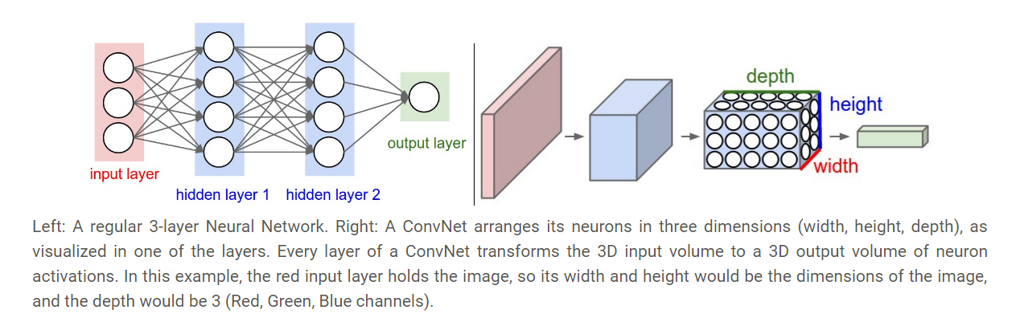
Dense neural network and Convolutional neural network

Slide 3
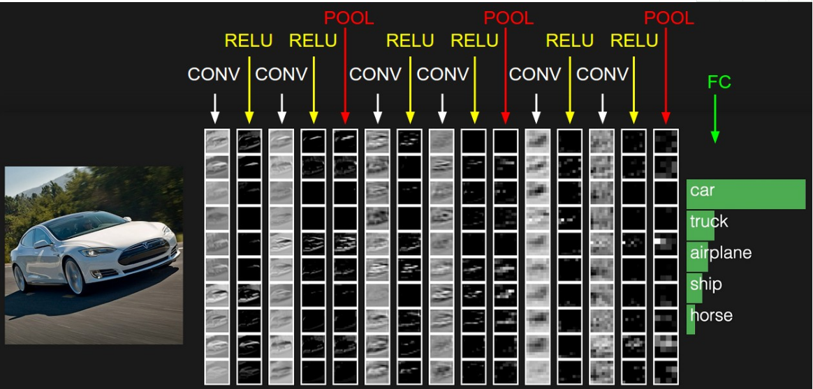
A simple CNN structure
CONV: Convolutional kernel layer
RELU: Activation function
POOL: Dimension reduction layer
FC: Fully connection layer

Slide 4
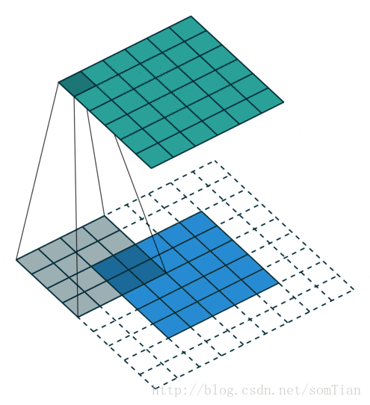
Convolutional kernel
This is a gif image

Slide 5
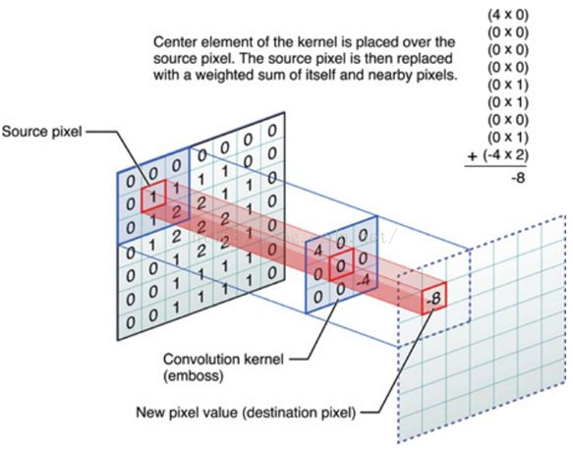
Convolutional kernel
Padding on the input volume with zeros in such way that the conv layer does not alter the spatial dimensions of the input

Slide 6
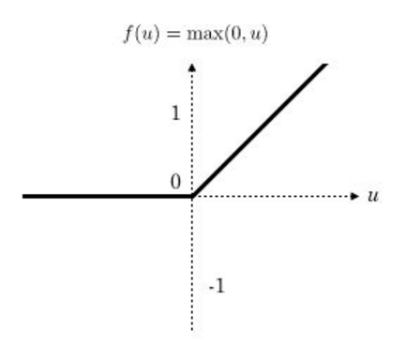
Rectified linear unit，ReLU

Slide 7
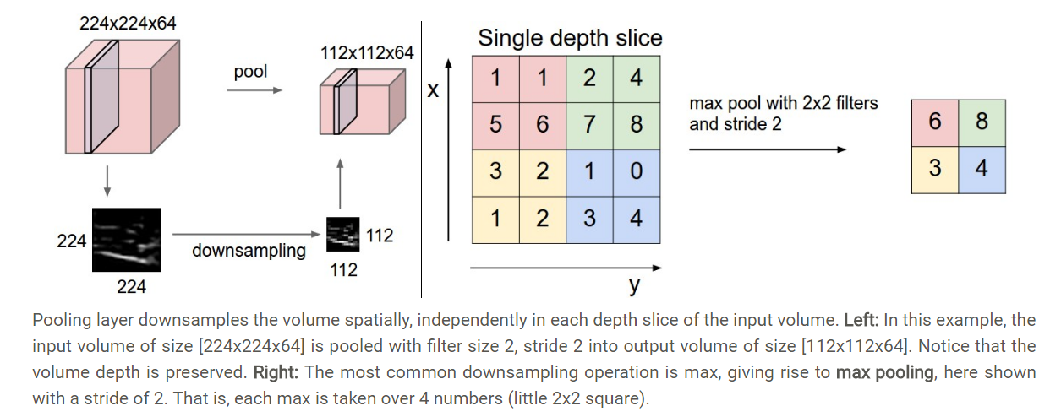
Pooling layer

Slide 8
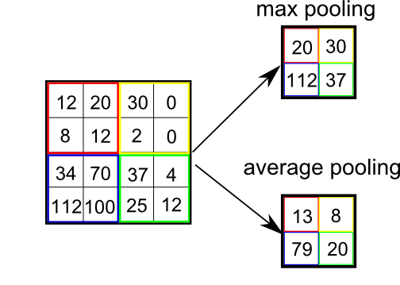
Pooling

Slide 9
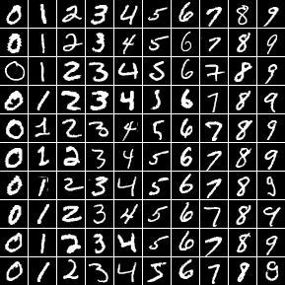
MNIST dataset
The MNIST database of handwritten digits,
available from this page,
has a training set of 60,000 examples, and a test set of 10,000 examples.
It is a subset of a larger set available from NIST.
The digits have been size-normalized and centered in a fixed-size image.

Slide 10
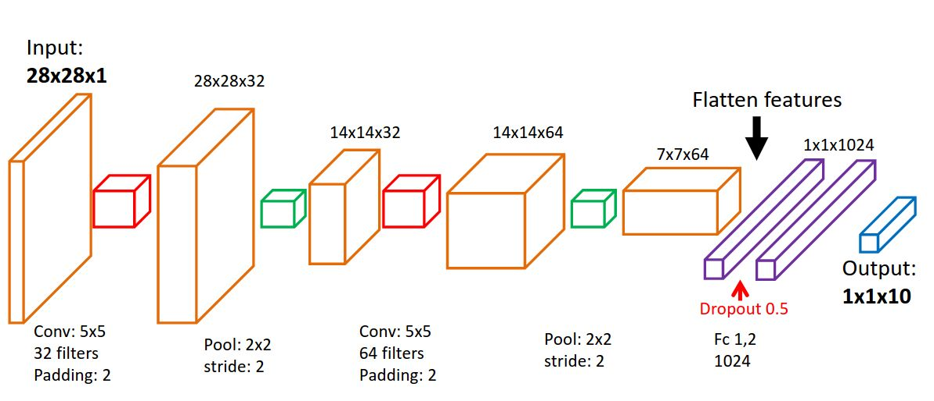
LeNet-5 for MNIST

Slide 11
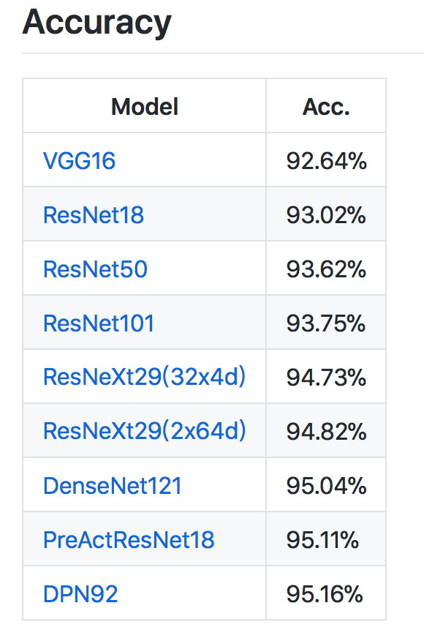
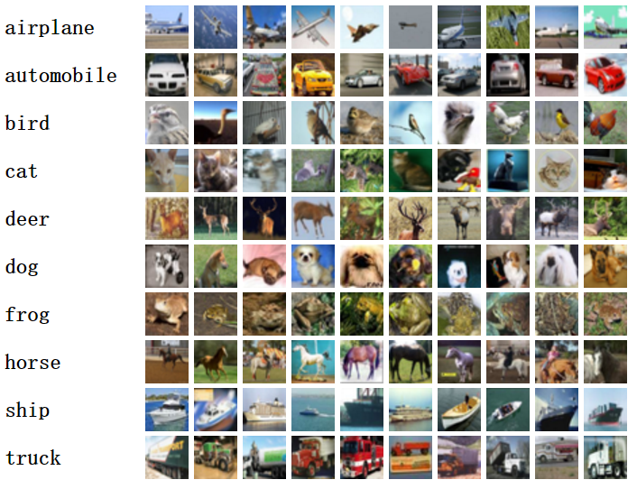
CIFAR10 dataset and state of the art
The CIFAR-10 dataset consists of 60000 32x32 color images in 10 classes,
with 6000 images per class. There are 50000 training images and 10000 test images.

Slide 12
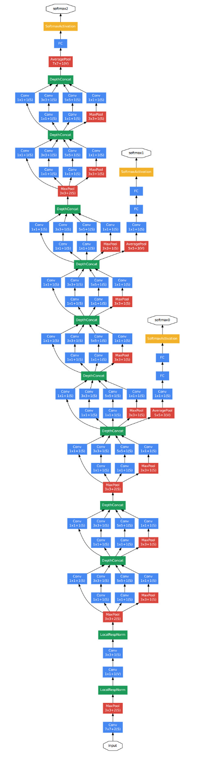
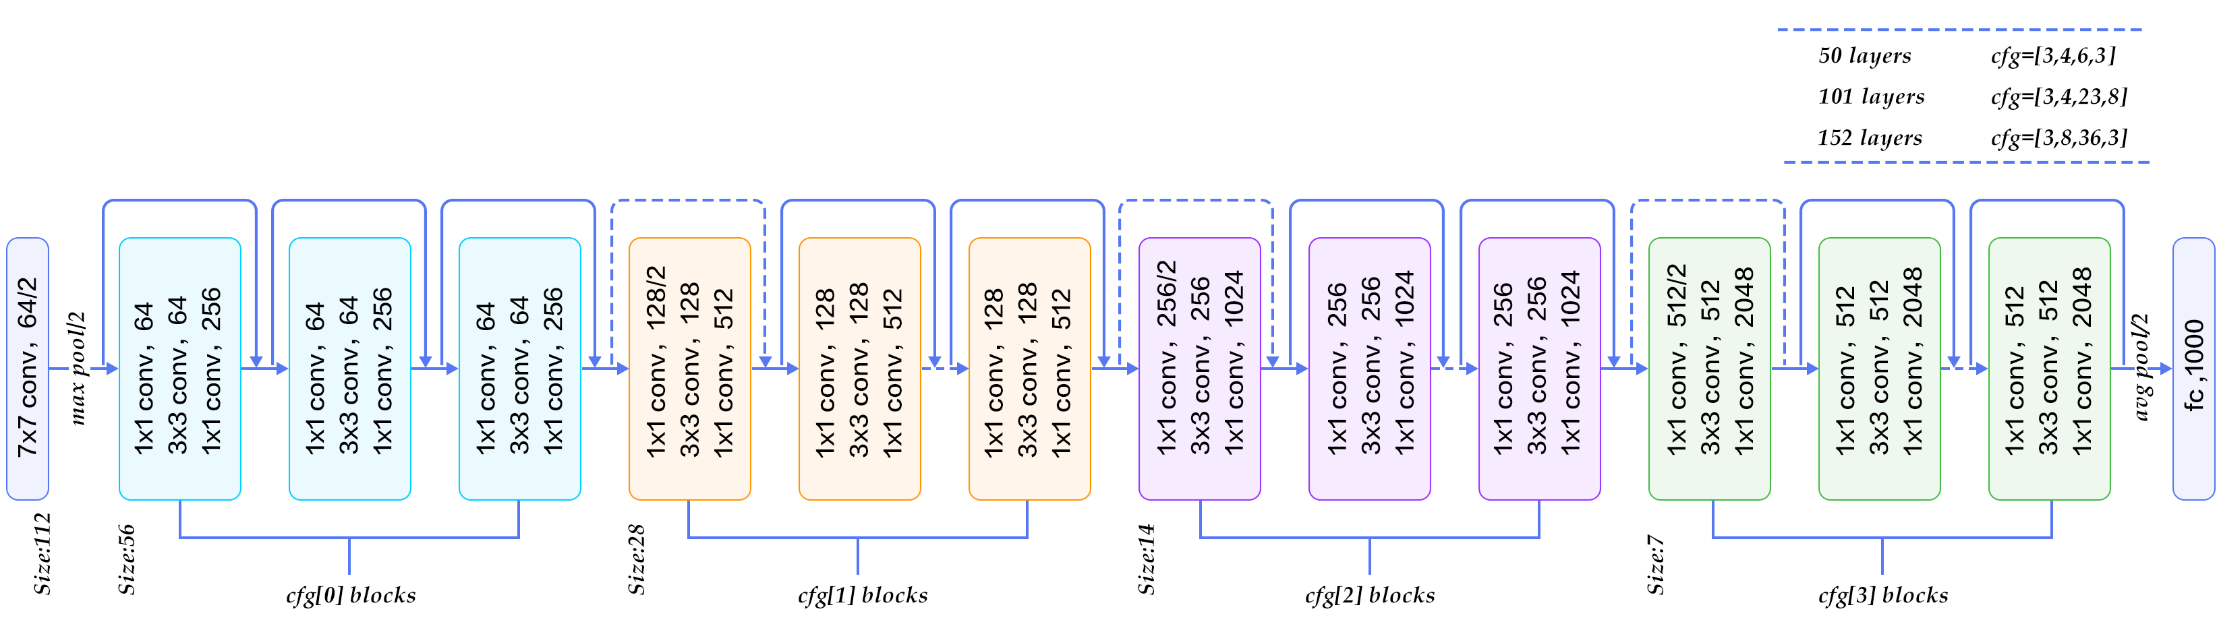
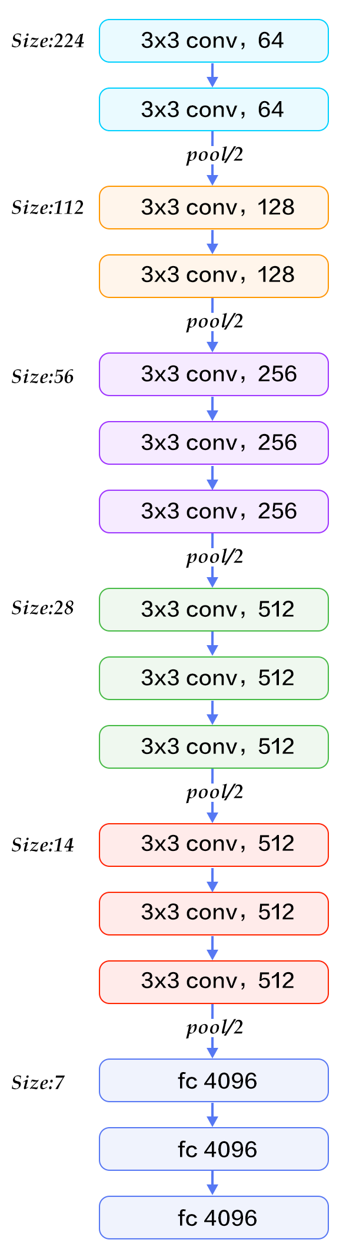
VGG-16
GoogleNet
ResNet

Slide 13
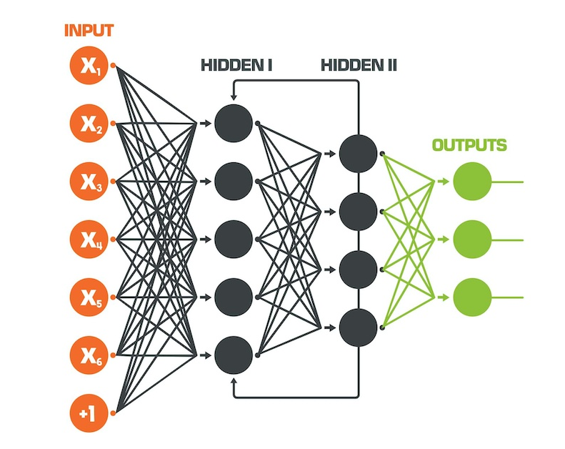
Recurrent Neural Network

Slide 14
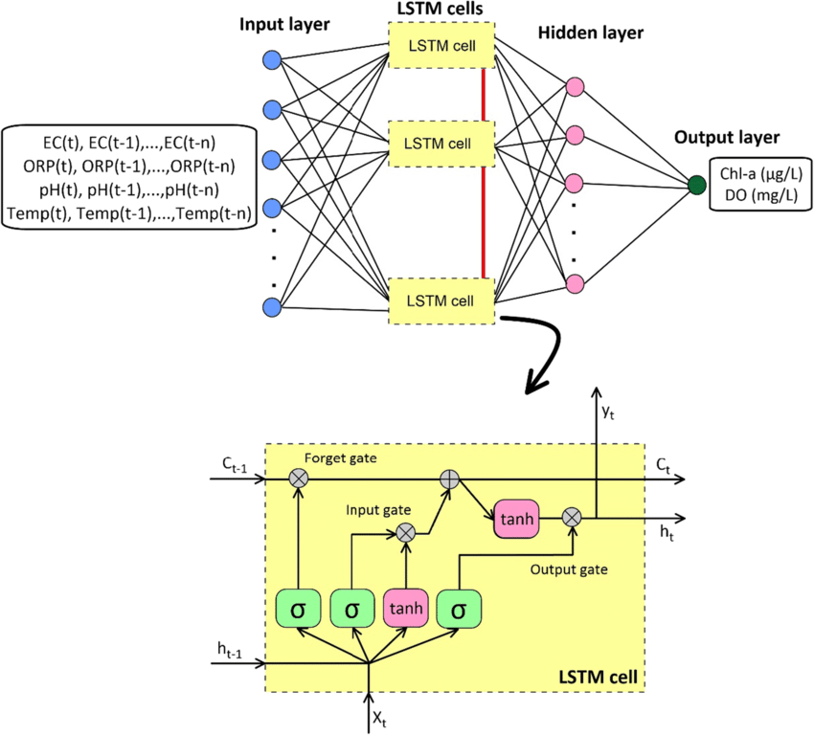
Long Short-Term Memory

Slide 15
Recurrent Neural Networks RNNs
1.Recurrent layer feedback loops are a feature of RNNs. They are able to keep
information in "memory" as a result.
2.Standard RNNs might be difficult to train to address issues that call for learning long-term temporal dependencies.
3.This is due to the loss function's gradient's exponential decrease over time (called the vanishing gradient problem).
Long Short-Term Memory LSTM
1.A form of RNN called LSTM networks employs special units in addition to conventional units.
2.A "memory cell" found in LSTM units is capable of storing data in memory for extended periods of time. They can learn longer-term dependencies thanks to this memory cell.
3.By adding new gates, such as input and forget gates, which improve control over the gradient flow and better preserve "long-range dependencies," LSTMs address the disappearing and expanding gradient difficulties.

Slide 16
THANK YOU

